Slide 1
Emoji
Prediction
Coursework project under guidance of Prof. Animesh Chaturvedi

Slide 2
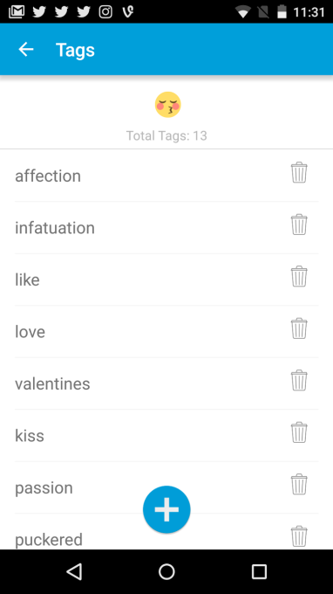
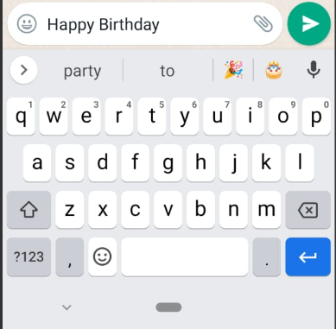
Introduction
People use emoji every day.
Emoji has become a new language that allows us to express ideas and emotions more effectively.
Right now, the keyboard on iOS/Android can predict emojis but only base on certain keywords and tags that are associated with emojis.

Slide 3
Problem statement
Emoji prediction, which estimates an upcoming emoji based on the given text, is considered to be one of the most important NLP tasks concerning emojis.
Our aim is to predict the most relevant emoji by considering the emotion detection task. Consider a tweet, and with the help of emotion detection - our model will predict emojis related to that text.
Emoji prediction is useful in multiple domains such as for sentiment analysis, emotion recognition, irony detection and hate-speech recognition.

Slide 4
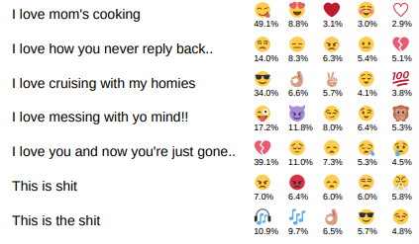
Literature review
The diversity of our emoji set is important for the performance of our method (Using millions of emoji occurrences to learn any-domain representations for detecting sentiment, emotion and sarcasm by Bjarke Felbo , Alan Mislove, Anders Søgaard, Iyad Rahwan, Sune Lehmann)
Experimental results indicate that extracting emotional information with emotion detection is beneficial to our main task, emoji prediction (MultiEmo: Multi-task framework for emoji prediction by SangEun Lee, Dahye Jeong, Eunil Park)
Ref: Felbo, Bjarke, et al. "Using millions of emoji occurrences to learn any-domain representations for detecting sentiment, emotion and sarcasm." arXiv preprint arXiv:1708.00524 (2017) , Lee, SangEun, Dahye Jeong, and Eunil Park. "MultiEmo: Multi-task framework for emoji prediction." Knowledge-Based Systems 242 (2022): 108437.
For each text the top five most likely emojis are shown with the model’s probability estimates.

Slide 5
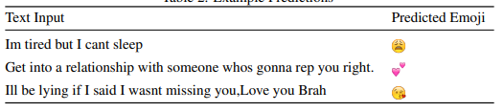
Literature review
People have different interpretations of emojis.
Cleaning up the dataset to remove nonsensical tweets may help improve the performance
Model which does word-by-word prediction would be efficient
(Using Neural Networks to Predict Emoji Usage from Twitter Data by Luda Zhao Stanford University ludazhao@cs.stanford.edu Connie Zeng Stanford University czeng2@cs.stanford.edu)
Ref: Zhao, Luda, and Connie Zeng. "Using neural networks to predict emoji usage from twitter data." Sementic Scholar (2017): 1-6.

Slide 6
Flowchart
Data
Exploratory data analysis
Preprocessing
Split data
Train Set
Test Set
Training Model
Fine Tune
Evaluate Model
Results

Slide 7
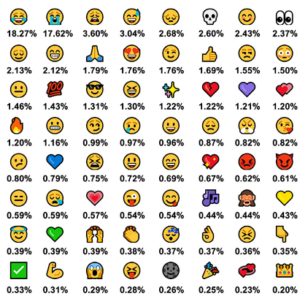
Twitter Dataset
Dataset has been taken from github repo of MultiEmo: Multi-task framework for emoji prediction research paper.
Each row represents a twitter post including at least one emoji of the top 64 emojis. The data we used for training includes posts with only one emoji.
Number of examples : 1,069,910.
Number of labels : 1

Slide 8
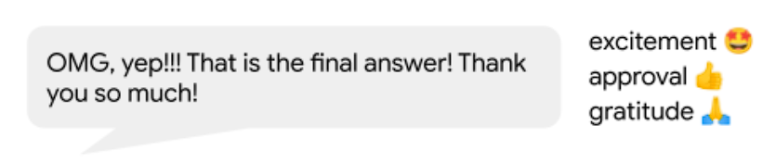
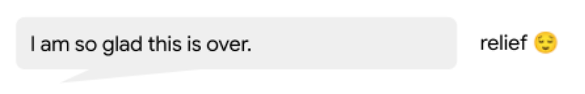
GoEmotion Dataset
Dataset has been taken from github repo of Google Research GoEmotion.
GoEmotions is a corpus of 58k carefully curated comments extracted from Reddit, with human annotations to 27 emotion categories or Neutral.
Number of examples: 58,009.
Number of labels: 27 + Neutral.
Maximum sequence length in training and evaluation datasets: 30.
The emotion categories are: admiration, amusement, anger, annoyance, approval, caring, confusion, curiosity, desire, disappointment, disapproval, disgust, embarrassment, excitement, fear, gratitude, grief, joy, love, nervousness, optimism, pride, realization, relief, remorse, sadness, surprise
Ref: GoEmotion Google research Blog

Slide 9
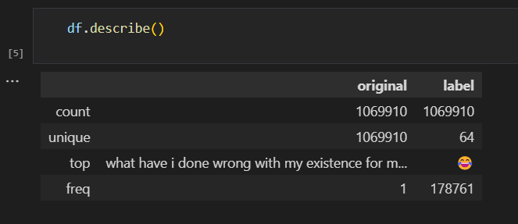
Exploratory Data Analysis
Some Libraries used for EDA
Short Summary of Data before EDA
Regular Expression
Seaborn
Counter
Pillow
Wordcloud
Natural Language ToolKit
Tqdm (Progress Bar)
Spacy

Slide 10
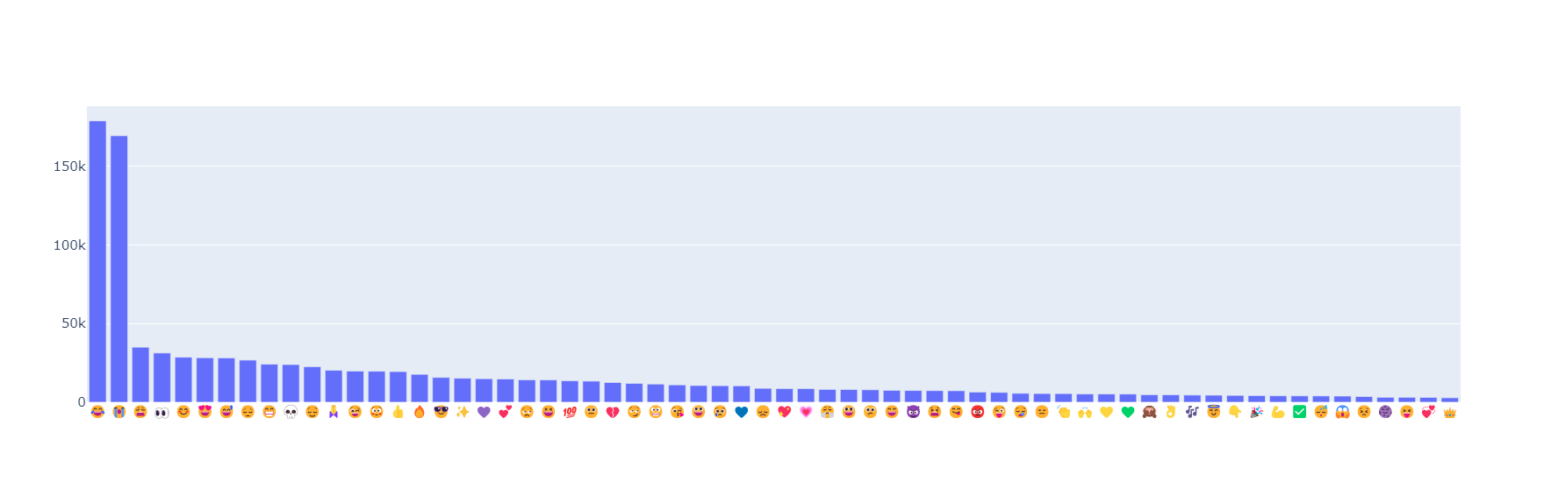
Data before making class
Number of sentences falling under particular emoji(64) in original Data

Slide 11
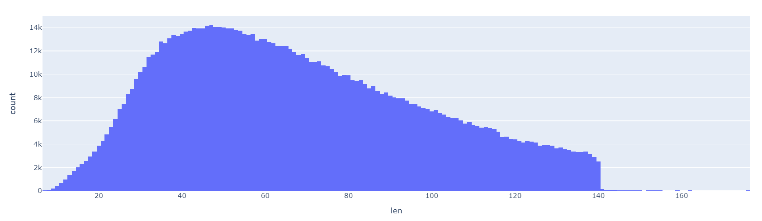
Tweets Length
Max length: 176, Min length: 7, Average Length : 68.27019562393099

Slide 12
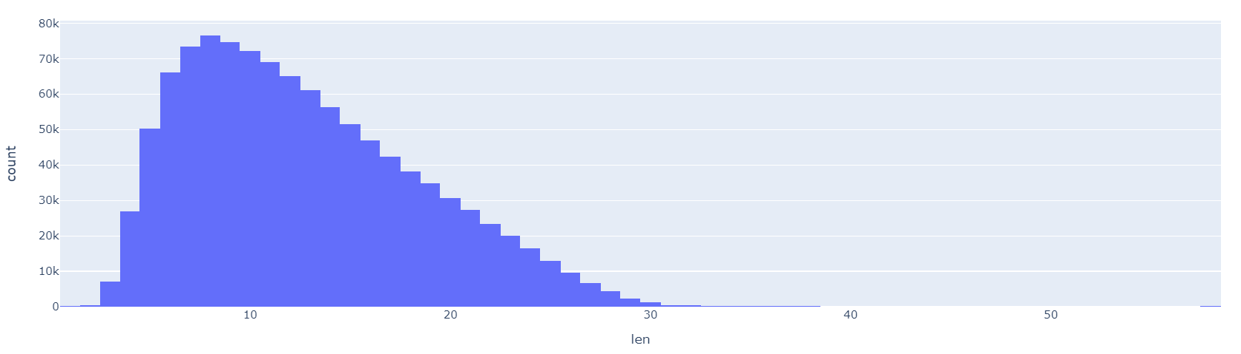
Count Of Words in a Tweet
Max: 58, Min: 1, Average : 12.716905160247123

Slide 13
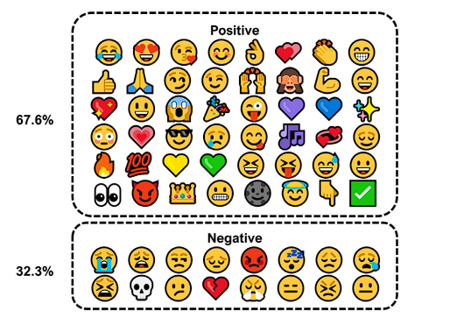
Dataset Splitting
Sentiment Prediction
0 → Negative
1 → Positive
7 New-Defined Labels
Happy : 😊 😉 😀 😃 🌚 😇 🎉 😅 😆 😎 😏 😈 😋 😜 😝 😌 😂😁 😄
Love : 💕 💖 💗 💙 💛 💜 💚 💞 😍 😘
Anger : 😡 😤 😑 😒
Sad : 😣 😩 😪 😫 😔 😞 😢 💔 😭 😕
Reaction : ✅ 💯 🔥👍 👏 👌 👀 💪 🙏 🙌 🙈
Misc : ✨ 🎶 👇 👑 💀
Various : 😬 😱 😳 😴 😐
Train Size : 454206 data points
Test Size : 113552 data points
Clustered emoji sentiments and their distribution
Ref: MultiEmo: Multi-task framework for emoji prediction

Slide 14
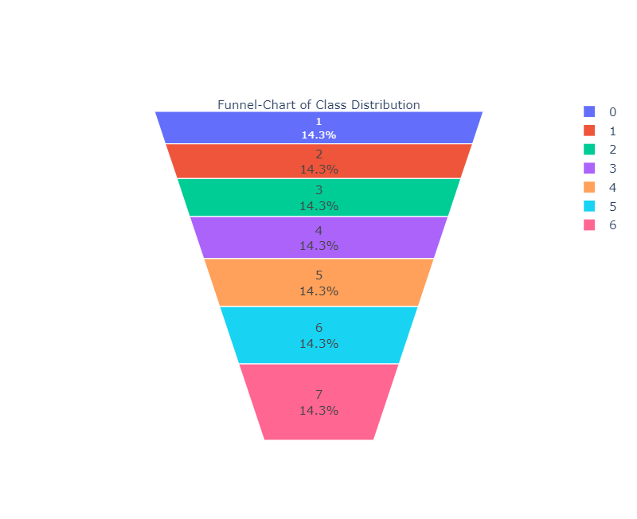
Emojis grouped into 7 classes
happy
love
anger
sad
reaction
misc
various

Slide 15
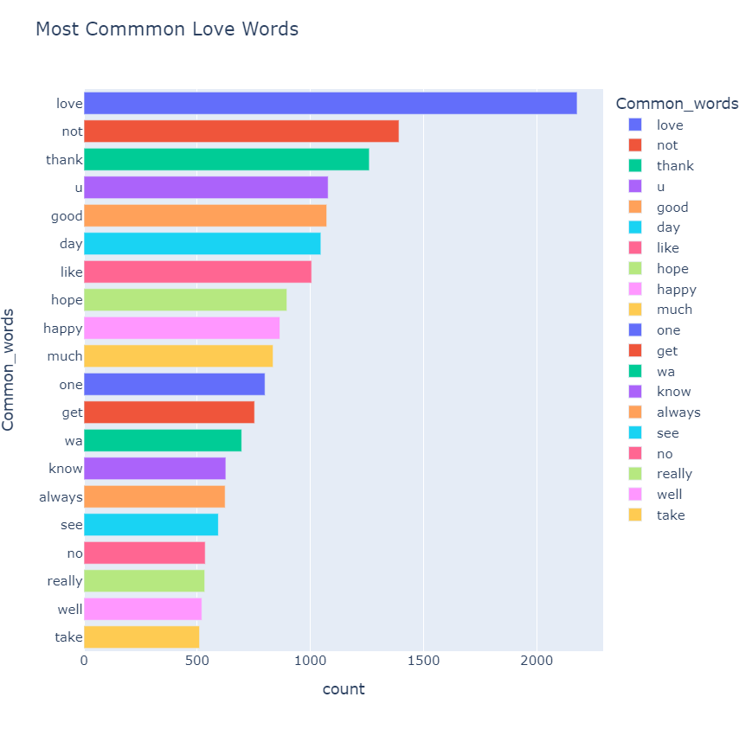
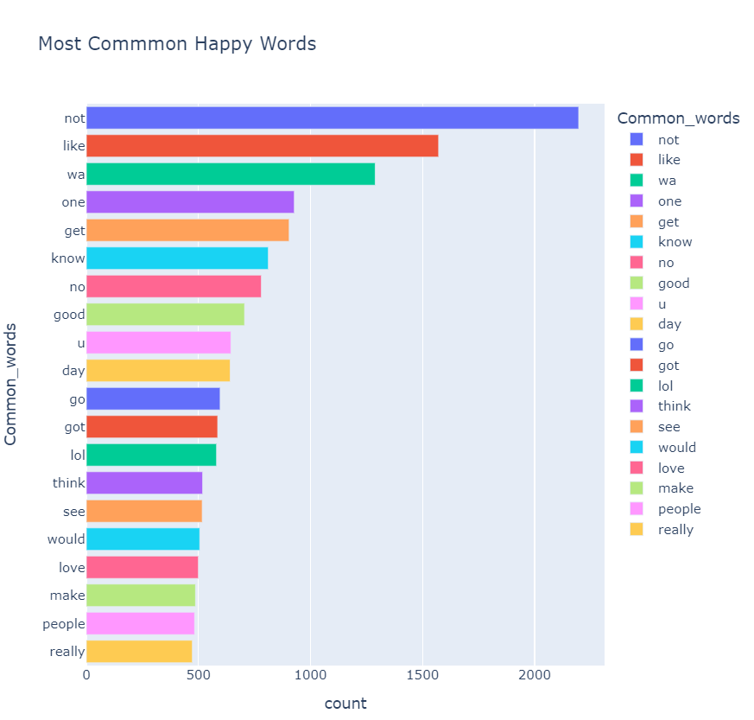

Slide 16
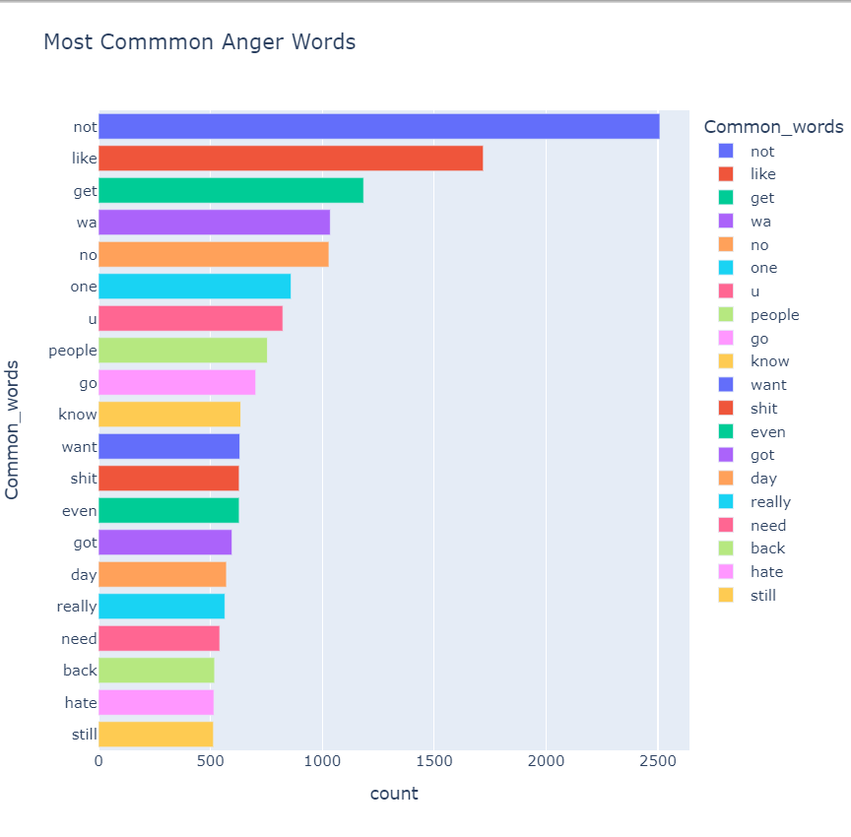
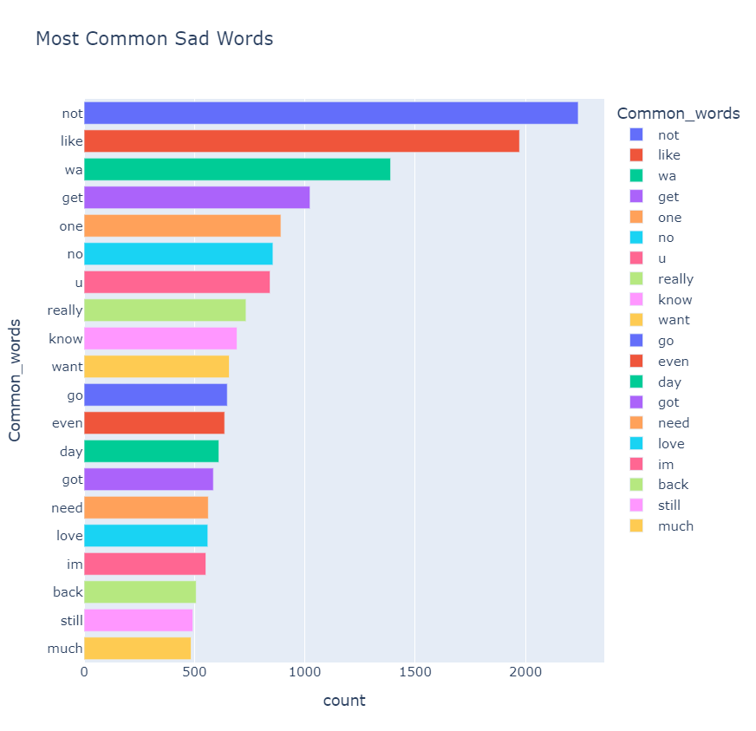

Slide 17
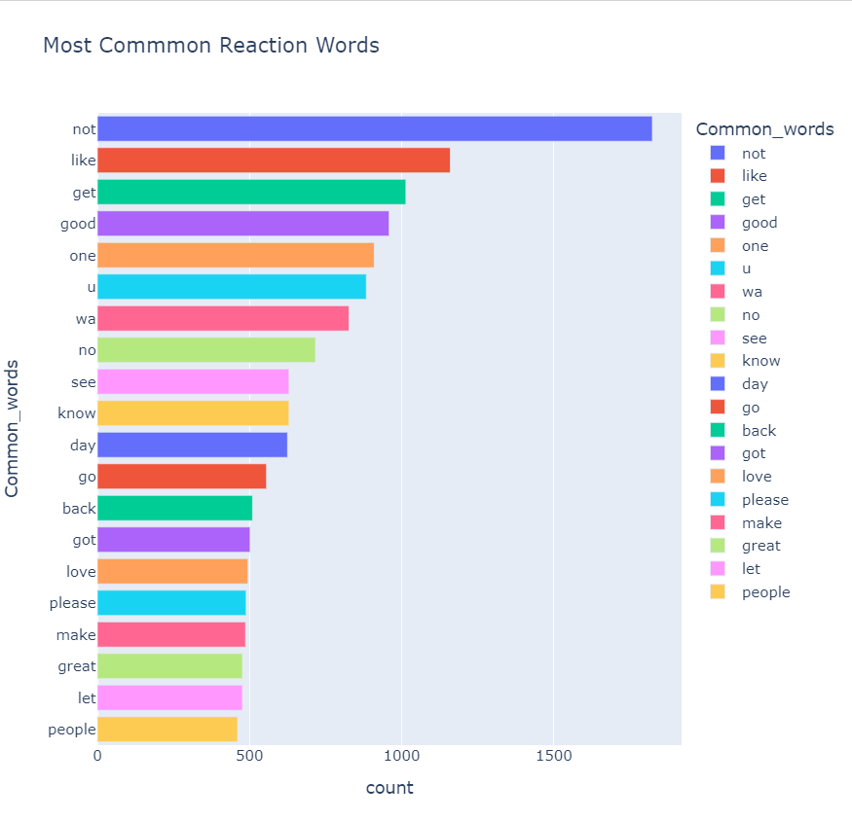
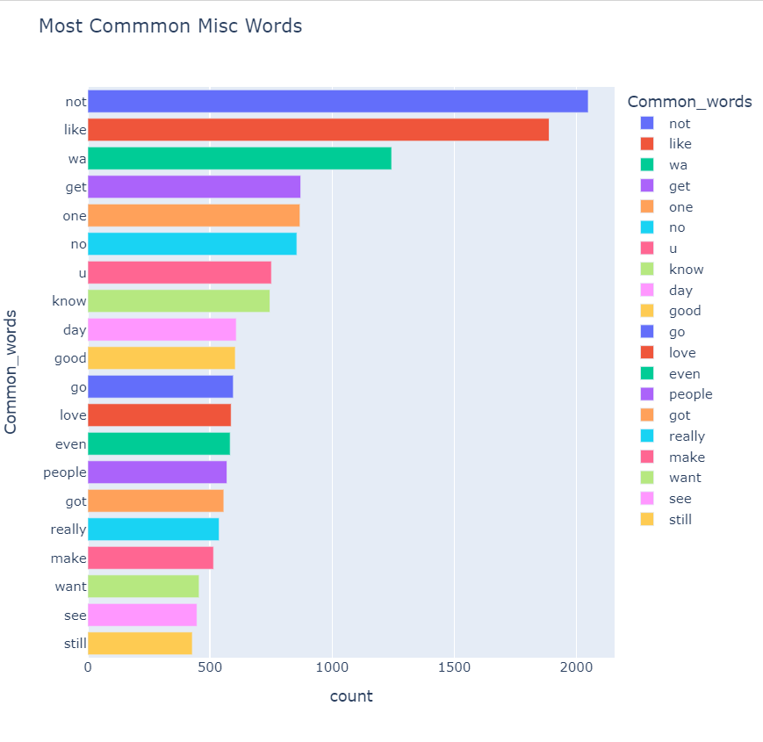

Slide 18
Preprocessing
Removed HTML tags
Lemmatization
Removed URLs
Stopwords
Accented chars
Spelling check
Chatwords
Punctuation
PreContraction
Removed username
Lowercasing
Unpack hashtag

Slide 19
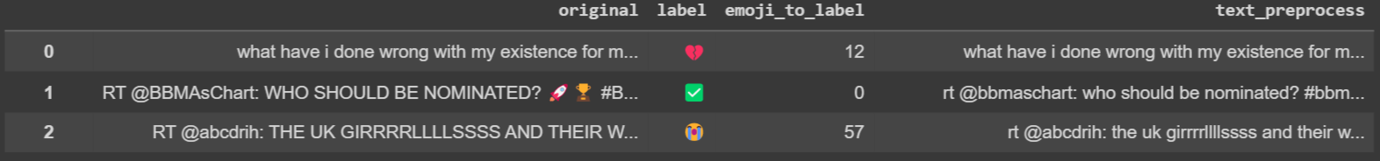
Examples
LowerCasing
Remove Emoji

Slide 20
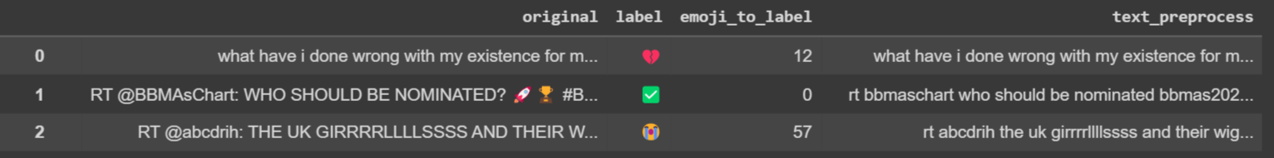
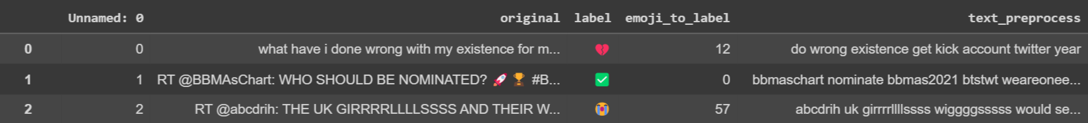
Remove punctuations
Removing stopwords
Lemmatize

Slide 21
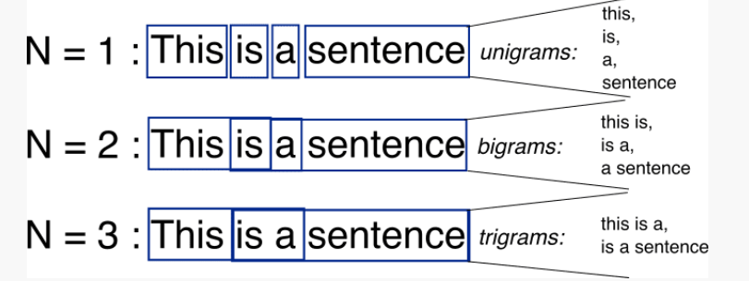
Bag-of-words Model
A bag-of-words model, or BoW for short, is a way of extracting features from text for use in modeling text, such as with machine learning algorithms.
Involves two things:
A vocabulary of known words
A measure of the presence of known word
For better results we use a bag of bigrams( a two-word sequence of words) representation than bag of words
Bag of word model based on word ngrams

Slide 22
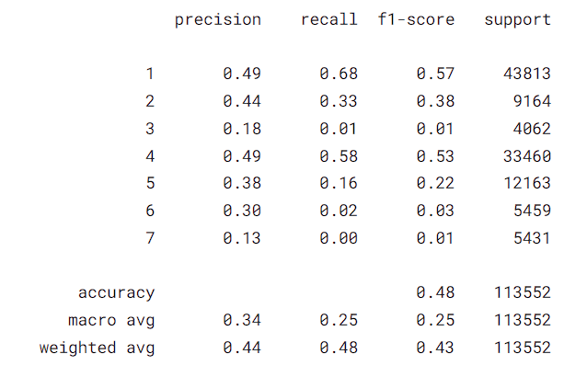
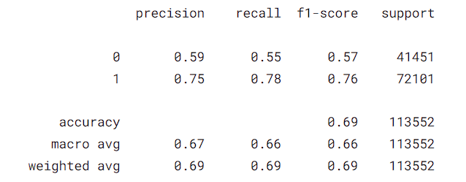
BOW Model
Results of Sentiment Prediction
Results of New-Labels Prediction
Best Results from MultinomialNB
Best Results from MultinomialNB

Slide 23
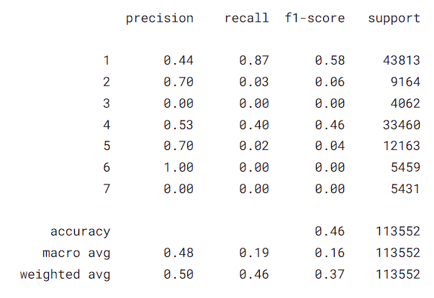
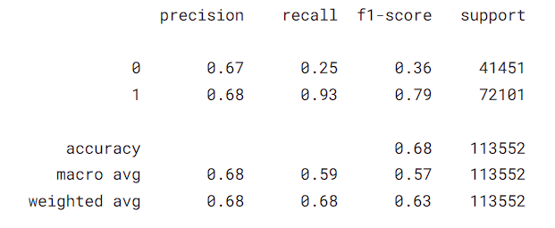
Tf-idF Model
Results of Sentiment Prediction
Results of New-Labels Prediction
Best Results from RandomForestClassifier
Best Results from MultinomialNB

Slide 24
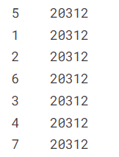

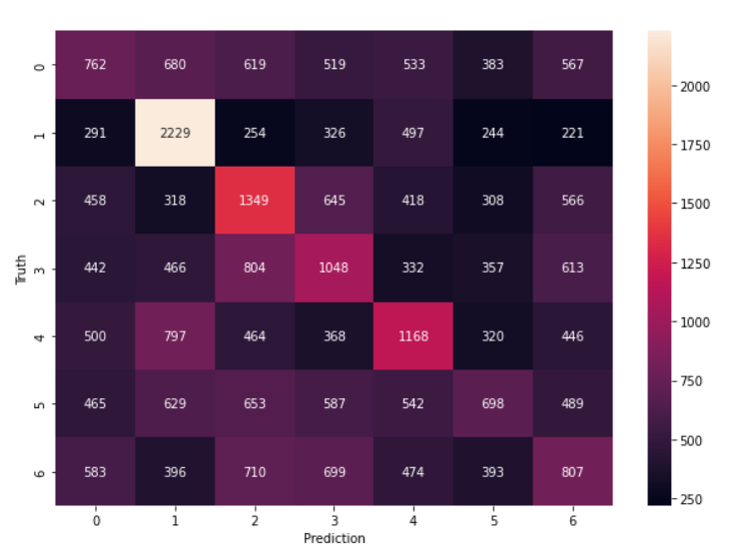
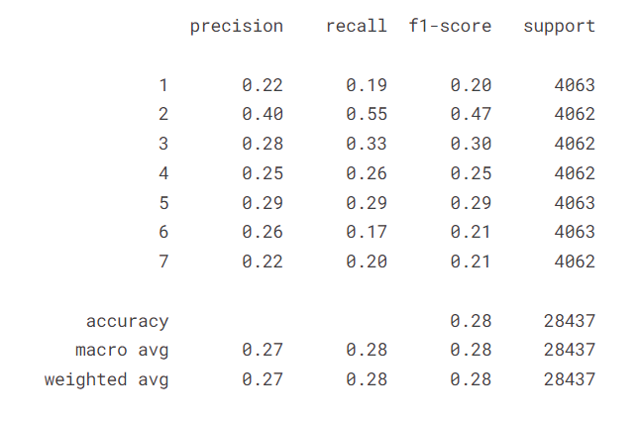
Tf-idF Model
Confusion Matrix for New-Labels
Prediction in Balanced Data
Best Results from MultinomialNB

Slide 25
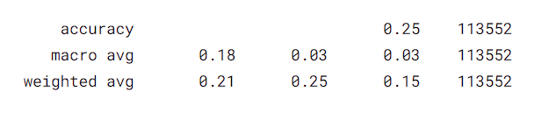
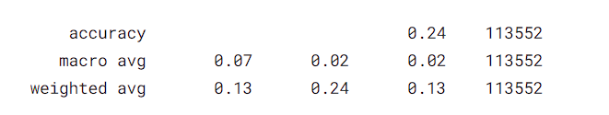
Prediction Result Over 64 Labels
Best Results from MultinomialNB
Results from BOW Model
Results from Tf-idf Model

Slide 26
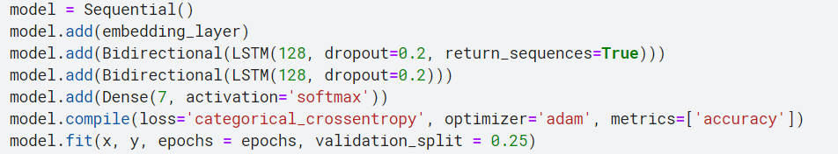
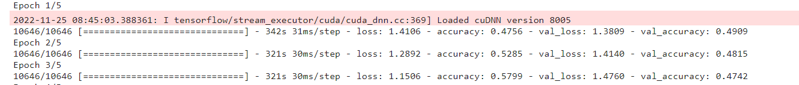
Other Models
Used GloVe embeddings common crawl 300 with 2x BiLSTM Model for new-labels prediction

Slide 27
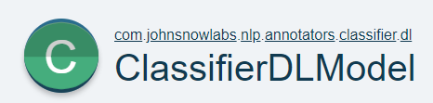
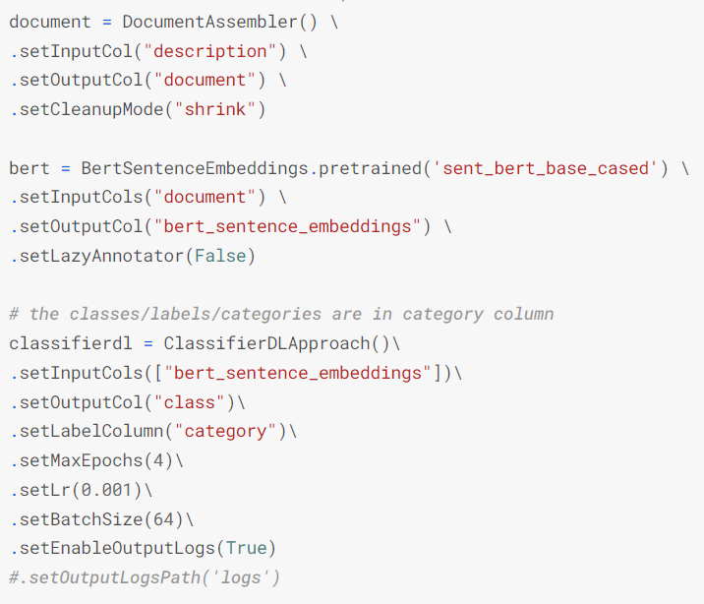
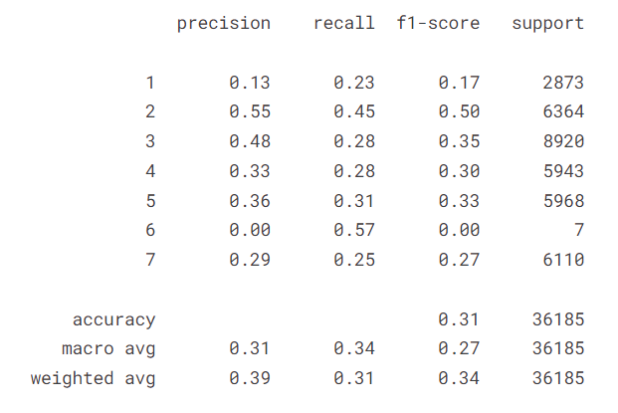
Other Models
Used BERT embeddings with NLP Spark Model for new-labels prediction.

Slide 28
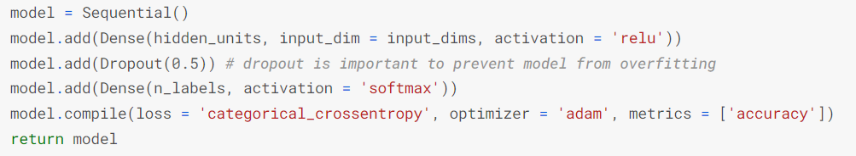
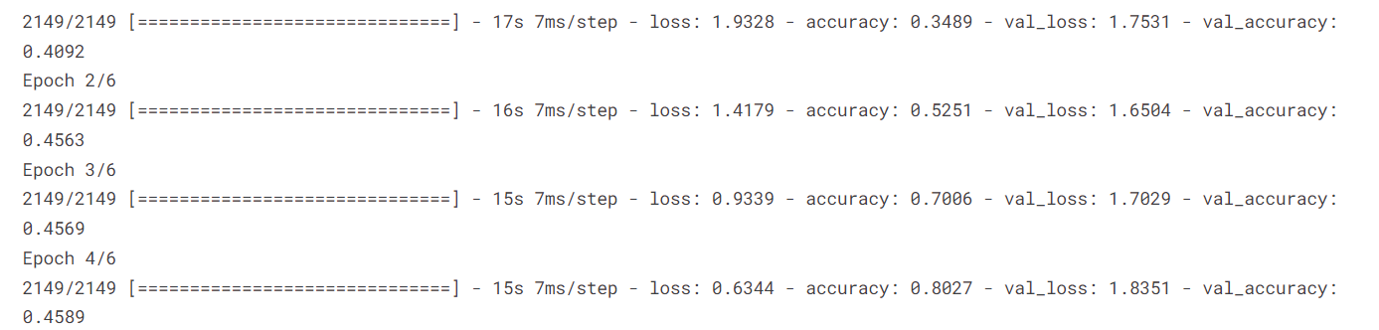
Other Models
Used bi-gram, tri-gram technique with simple RNN for top 10 emoji prediction in dataset.

Slide 29
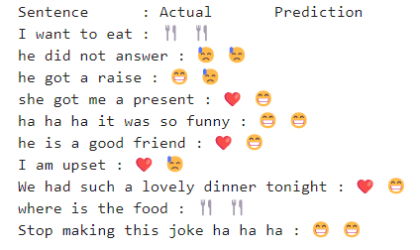
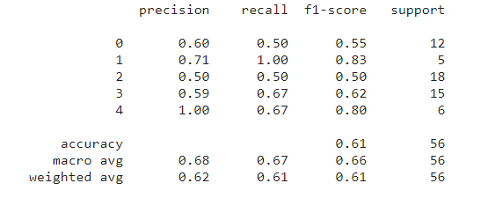
Other Models
Used GloVe 50 embeddings common crawl 50 with 2 LSTM layers for 5 emoji prediction with small dataset.
182 data-points with 5 labels (🍴😁💗😓⚽😂)
Ref : Zhao, Luda, and Connie Zeng. "Using neural networks to predict emoji usage from twitter data." Sementic Scholar (2017): 1-6.

Slide 30
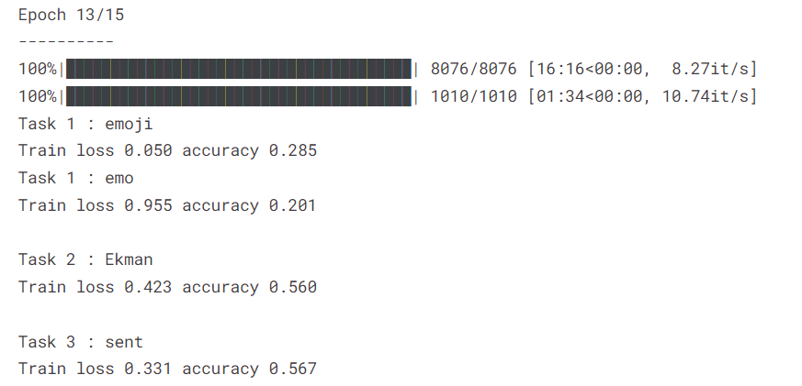
MultiEmo
Text Embedding
Detecting Emotion
Tweet Text
2x BiLSTM Layer
Attention Layer
Emoji Prediction
Dense Layer
Ref: DeepMoji Architecture , MultiEmo: Multi-task framework for emoji prediction

Slide 31

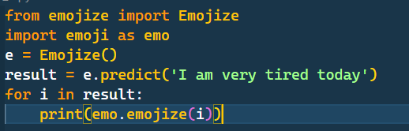

DeepMoji Model
Top 3 Emoji Prediction
From a dataset of 55 billion tweets, we find tweets with emojis and train a deep learning model to predict which emoji was included with what tweet. The basic idea is that if the model is able to understand which emoji was included with a given sentence
Ref : Felbo, Bjarke, et al. "Using millions of emoji occurrences to learn any-domain representations for detecting sentiment, emotion and sarcasm." arXiv preprint arXiv:1708.00524 (2017).

Slide 32
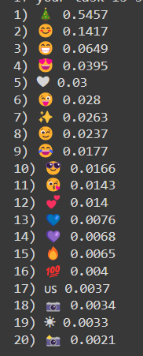
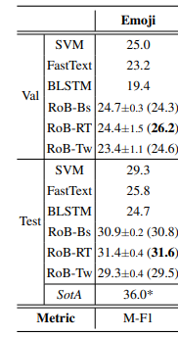

This is a roBERTa-base model trained on ~58M tweets and fine-tuned for emoji prediction with the TweetEval benchmark.
Repo :cardiffnlp/twitter-roberta-base-emoji
Ref : Barbieri, Francesco, et al. "Tweeteval: Unified benchmark and comparative evaluation for tweet classification." arXiv preprint arXiv:2010.12421 (2020).

Slide 33
Thank You

